Slide 1
Evolution of Corporate
Law & Finance
Business Associations section 7a
History: How did business entities evolve?
Prof. Amitai Aviram
Aviram@illinois.edu
College of Law
University of Illinois
Copyright © Amitai Aviram. All Rights Reserved
S12

Slide 2
History
Overview of Section 7a
Course overview
  Administrative details of the course
  Writing a research paper
  Economic and legal history methodologies
Pre-capitalist economic systems
Commercial capitalism
Industrial capitalism

Slide 3
How is this seminar different from other classes I teach?
Less practitioner-oriented
  Most of my classes put you in the corporate lawyer’s seat
  Unfortunately, few clients are willing to pay for a thoughtful historical survey of corporate law
  But understanding the history & economics of law’s development will help you understand the law better & come up with clever legal arguments

Slide 4
How is this seminar different from other classes I teach?
Much less lecture; much more discussion
  Require you to actively talk in class
    More reading than in most of my classes
  Because discussion responsibilities are significant -
    Paper length requirement is very modest
    Required to lead discussion only in designated classes

Slide 5
How is this seminar different from other classes I teach?
Much less lecture; much more discussion
  Typical class structure
    First 20 minutes: I lecture, laying the background to the issue we are discussing
    Remaining time: Discussion leaders present & moderate discussion
      Review the assigned reading material
      Highlight questions/observations that arose from the material
      Pose questions to the rest of the class
      Other students are expected to add their own thoughts/insights/questions

Slide 6
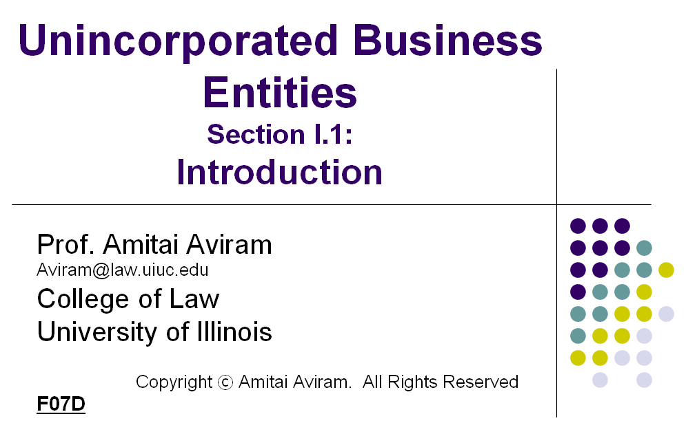
PowerPoint slides
  PowerPoint Slides, reading assignments and syllabus are all posted and regularly updated on my website
  http://www.law.illinois.edu/aviram/
  Date of slides marked on
  bottom left of the first slide
    F07D: Fall 2007 – Draft
    F07: Fall 2007 – Final
    S07: Spring 2007

Slide 7
Grading
Research paper
  Topic of your choice, as long as it’s related to the course
  No minimum or maximum length
  Expected length: about 10 pages
Grade adjustments
  Up to 1 grade-point up, unlimited adjustment down
  However, an upwards or downwards adjustment of more than ⅓ of a grade point (e.g., from B+ to A-) is rare

Slide 8
Grading
Grade adjustments
Attendance & participation in class discussion
Discussion leading (team activity)
Presentation of your paper
  15-20 minutes (4 students per class)
  Conducted in the last classes of the semester
  Students present by alphabetical order of their last names, unless they agree to swap places

Slide 9
Discussion leading
Coordinating participation
Discussion leading team should coordinate:
  Speaking order
    Default: by alphabetical order of last names
  Which topics/ideas each student will cover
  Brainstorming for questions, outside material etc.

Slide 10
Discussion leading
How to Prepare
Good participation
  Read assigned material
  Write down insights, puzzles & questions that come up
  Brainstorm with the rest of your team
  Decide: lecture or lecture/discussion mix?
    Lecturing gives you more control, but can be less engaging
    Discussion works best when it involves activities (e.g., team work) or a narrow but not obvious question
Excellent participation
  Follow up on your insights & questions by searching for more relevant material

Slide 11
Research paper
Your choice of topic, as long as it’s related to the history of business organizations law or finance
  Clever, innovative thesis
  Good execution (substantiating the thesis with evidence)
Expected length: ~10 pages (including footnotes)
  If you want ULWR credit: 6,000 words (not counting FNs)
Due on the last day of classes in the semester
  Submit the paper by e-mail (aviram@illinois.edu)
More about how to write a research paper later

Slide 12
Talking to me outside of class
Please e-mail prior to meeting with me
  Suggest when you would like to meet (not limited to office hours)
  Describe what issues you want to talk about
E-mail: Aviram@illinois.edu
Room 326

Slide 13
Writing a research paper

Slide 14
Writing a research paper
Process
Picking a thesis
  Deciding on a topic
  Researching the topic to determine the thesis
Writing an outline & abstract
Writing a draft
Polishing

Slide 15
1. Picking a thesis
The most important part
Thesis is the single most important part of your paper
Everything else exists to:
  Explain your thesis
  Support your thesis (evidence)
  Explain the implications of the thesis (why it is important?)

Slide 16
1. Picking a thesis
Topic vs. thesis
Topic: A narrow area of law, place and time
  Partnerships in Pre-modern China
  Limited liability in popular culture in France and England, 1850-1900
  Delaware’s Rise to Corporate Law Prominence
  Not: “Mergers & Acquisitions”, “Limited Liability Companies”
  Borderline: Business Entities in colonial Virginia
Thesis: A claim about something within your topic; E.g.,
  Case X should be interpreted in the following way…
  The First Amendment is the main reason the American states adopted general incorporation statutes earlier than most European countries
  Muslim law did not independently develop corporate law because…
  Business ventures are organized in the following way in virtual worlds…

Slide 17
1. Picking a thesis
(a) Deciding on a topic
Choose a topic in which you have some competitive advantage over others in researching. E.g.,
  Knowledge of methodology
  Knowledge of language, culture, law, etc.
Choose a topic that interests you
  It takes a lot of discipline to do adequate research, and it's easier to gather this discipline when you enjoy the topic you are researching
Choose a topic that is researchable
  I.e., make sure that you are able to access the information needed for your research

Slide 18
1. Picking a thesis
(b) Researching the topic to determine the thesis
Thesis can be analytical or synthetic
  Analysis: Use various evidence to prove a new claim
  Synthesis: Survey others’ analyses regarding the claim
All else equal, analytical theses are better
  Good paper w/analytical thesis → Excellent paper
  Good paper w/synthetic thesis → Adequate paper

Slide 19
1. Picking a thesis
(b) Researching the topic to determine the thesis
Analytical thesis should be:
Novel
  A claim no one has made before
  New type of evidence supporting a disputed claim
  Expanding an existing claim to new areas
Non-obvious
  Isn’t automatically accepted as true without supporting evidence
Sound (supported by evidence & balanced)
  The evidence you present would persuade a reasonable person that your claim is correct
  Rule of thumb: If it sounds like a debate or an op-ed, it’s not “sound”

Slide 20
1. Picking a thesis
(b) Researching the topic to determine the thesis
Synthetic thesis should be:
Thorough
  All significant relevant sources presented
Fair
  Each source is accurately presented
Organized
  Fit others’ scholarship into categories & patterns

Slide 21
1. Picking a thesis
Common pitfalls
The over-broad thesis (raises too many sub-issues)
Thesis on a matter that cannot be generalized
  E.g., Should CEOs be fired for backdating stock options?
Falling in love with your thesis
  Ignoring evidence that thesis is wrong or not novel
Thesis lacks supporting evidence; relies on persuasion
  Remember: This is a research paper, not a brief!

Slide 22
1. Picking a thesis
Process
Pick a topic (competitive advantage, interest, researchable)
Conduct initial research (at least 5 different sources)
  Treatises, legal encyclopedias are a crash course to the law
  Law review/SSRN articles flag current debates & “hot issues”
  Talk to reference librarians (not only at the law library)
Pick a tentative thesis
  Analytical (novel, non-obvious, sound) or synthetic (thorough, fair, organized)?
The “Add/Drop Period” - Focus your research to:
  Ensure that the thesis is novel & correct
  Fine tune or change the thesis if it’s not novel or not correct
Decide on a final thesis

Slide 23
1. Picking a thesis
Tips
Start with the narrowest topic and expand if necessary, rather than the other way around
Taking a contrary position to an established view almost ensures that your thesis is novel, non-obvious and important
  Pitfalls
    Relying on persuasion
    Falling in love with the thesis

Slide 24
1. Picking a thesis
Tips
Most important: Seek your competitive advantage

Slide 25
2. Writing an outline & abstract
Organizing the logic of your argument
Abstract: Summary of the paper (1-3 paragraphs)
  Allows you to briefly describe your paper to someone else
Outline: Title/content of each section and sub-section
  The future “Table of Contents” of the paper
  Typical depth: 3 levels
  Breaks down the research into manageable pieces

Slide 26
3. Writing a draft
Filling in the outline
Usually start with an introduction that addresses:
  What is your thesis?
  How is it different from what was written before?
  Why it is important?
  Outline of the paper’s structure
Focus on each sub-section at a time
  Before writing, have an idea of what this sub-section will say
  Don’t get bogged down in details at this stage – drop a footnote or highlight a note to yourself when you need to find a minor reference/citation

Slide 27

3. Writing a draft
Primary vs. secondary sources
Sources to support your thesis are divided into:
  Primary sources: Sources that are not based on any other existing source (but may be based on lost sources)
  Secondary sources: Sources that are based on an existing source
Research execution is better the more it relies on primary sources

Slide 28
3. Writing a draft
Primary vs. secondary sources
Some sources contain primary & secondary portions
  E.g., a court decision describes the history of a rule, leading it to decide the case in a certain way
    Primary source – for the law created by this case
    Secondary source – for the history of the rule
Some sources are primary or secondary depending on the claim they support
  E.g., a U.S. court decision addresses French precedents
    Primary: for the point that U.S. courts considered French law
    Secondary: for the description of the French law on the issue
  If your thesis is synthetic, many sources the would otherwise be considered secondary would be considered primary

Slide 29
4. Polishing
Final touches
Go over all highlighted notes and fill necessary references/quotes/text
Re-read your paper
  Typos
  Grammar
  Unnecessary Repetition
  Confusing language
  Disconnect between sub-sections of your paper
If possible, have a friend read the paper to pick up places in which you are unclear

Slide 30
Research paper
Common topics
Case History
  E.g., Behind the scenes of Smith v. Van Gorkom
Development of legal doctrine X [place, time]
  E.g., Development of the BJR in US law in the 20th Century
Development of business technique Y [place, time]
  E.g., SH preemption rights in the UK, 1750-1950
Economic circumstances in period Z, and their impact on [corporate, partnership, etc.] law
  E.g., The effects of the War of 1812 on US corporate law

Slide 31
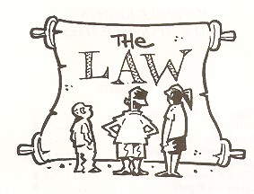
Economic & legal history methodologies

Slide 32
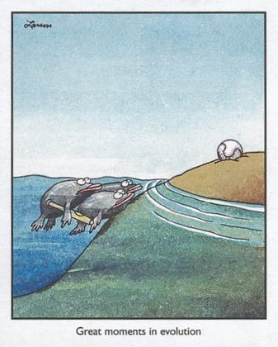
Evolution of corporate law
Key questions
How did a certain aspect of corporate law evolve?
Why did this evolution take place?

Slide 33
How did a certain aspect of corporate law evolve?
Factual question
Consider not only the evolution of the law itself, but also of supporting institutions & business customs
For example, the development of laws governing shares (e.g., joint stock companies) was limited until:
  Partnerships began to allow partners to freely transfer their partnership (business custom); and
  Stock exchanges developed (supporting institution)

Slide 34
Why did this evolution take place?
Path-dependent explanation
A path-dependent explanation is based on the argument that the law is a result of a specific event, person, etc.
Implied arguments
  But for the event/person, the law would have been different
  If the event had not occurred/ person not been in that position, a similar event/person would not have emerged

Slide 35
Why did this evolution take place?
Path-dependent explanation
Example
  Early corporations carried out public functions that government “outsourced” to the private sector (e.g., capturing & controlling new lands, building turnpikes and railways, raising taxes)
  Therefore, early corporations were seen as extensions of the state, and constitutional law seemed a good analogy
  As a result, some aspects of constitutional law were imported into corporate law
Path-dependent argument: If early corporations had carried purely private functions (e.g., manufacturing, retailing), certain concepts imported from constitutional law would not have become part of corporate law

Slide 36
Why did this evolution take place?
Structural explanation
A structural explanation points to certain forces that determine what law emerges, and demonstrates how the equilibrium of these forces resulted in the law being the way it is
Implied arguments
  Forces mentioned are the ones that matter
  If a given event/person were removed, another event/person would have eventually caused the same results

Slide 37
Why did this evolution take place?
Structural explanation
Reconsidering the constitutional law influences example, a structural explanation could argue the following points:
  Early corporations had to have quasi-public functions, because it made no sense for a private firm to become a corporation [I think this argument is wrong]
  Once corporations with private functions became common, corporate law shifted to borrowing less from constitutional law, and that law’s influence on corporate law has diminished
  Corporations pose the same political threats as governments (or pose the same agency problem), and therefore constitutional law is a good analogy, regardless of the character of early corporations

Slide 38
Structure of course material
  History: eras of biz org evolution
  Pre-capitalist
  Commercial capitalism
  Industrial capitalism
Law: what are the main legal traits of the corporation and how did they develop?
  Regulation of financial transactions (e.g., lending)
  The corporate entity (legal personality & limited liability)
  Corporate governance (centralized management & investor ownership)
Evolution: what forces shape modern corporate law?
  Corporate law & the business cycle
  Regulatory competition
  Legal origins (path dependence)
The future of business organizations

Slide 39
History
Overview of Section 7a
Course overview
Pre-capitalist economic systems
  Overview of our theoretical framework
  The guild: pre-capitalist manufacturing
  The manor: pre-capitalist agriculture
Commercial capitalism
Industrial capitalism

Slide 40
Evolution of business entities
Theoretical framework
Why do we have certain business entities when we do, and why do they change?

Slide 41
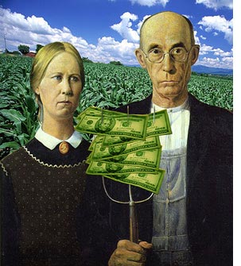
Theoretical framework
What do biz entities do?
The goal of business entities is to facilitate the interaction between people who possess the resources needed for the business
  Business ideas (entrepreneur)
  Money (shareholders, creditors)
  Management skills (managers)
  Other skills (employees)

Slide 42
Theoretical framework
Biz entity vs. contract
The same can be done by contract
In fact, the same IS typically done by contract re:
  Money (lending agreements)
  Management & other skills (employment contract)

Slide 43

Theoretical framework
Biz entity vs. contract
The use of a business entities (rather than contracts) benefits from economies of scale
  Contracts are easily tailored to specific needs of parties
  But if there are many parties involved, managing all the relationships is very complex

Slide 44
Theoretical framework
Biz entity vs. contract
Example 1: Small bakery requires 2 employees, no manager, 1 person to finance business
  If organized as a firm: 3 relationships (2+1)
  If organized as a set of contracts: 2 relationships (2x1)
    2 employment contracts w/financier; or
    2 lending agreements w/employees
Example 2: Mid-size steel plant requires 100 employees, 10 managers, 10 people to finance
  If organized as a firm: 120 relationships (100+10+10)
  If organized as a set of contracts: 10,000 relationships (100x10x10)

Slide 45
Theoretical framework
Biz entity vs. contract
Bottom line
  In small businesses, a simple lending contract (financier is a creditor) may be more attractive than using a standardized business entity (financier is a partner/shareholder)
  The larger the business, the more complex it becomes to use only contracts to manage the parties relationships
The historical pattern
  As markets served by businesses grow, the business becomes larger and involves more parties
  This forces the parties to shift from contracts to entities & requires new forms of business entities to develop

Slide 46
Theoretical framework
What makes markets grow?
Food Surplus / Pop. Density
Food Surplus (+)
Capital/Labor Ratio
Ag Tech
Population Density (-)
Trans Tech
Fast, Cheap Movement of Info & Goods
Com Tech
Market Size
Scale of Production
Capital Intensity
Efficient, reliable energy
Efficient, continuous production
Business Entity Law
Mil Tech
Security

Slide 47
Theoretical framework
Structures of business integration
Market
  Individuals act independently; contract with each other to integrate their activities
  E.g., farmer’s market
Association
  Individuals each profit separately, but association enforces rules that all of them must follow
  E.g., Guild; analogy: condo
Enterprise
  Enterprise makes the profit, not individuals separately; enterprise tells individuals what to do
  E.g., corporation

Slide 48
Theoretical framework
Structures of business integration
 | Market | Association | Enterprise
Operation | Incentives (prices) | Group decision | Control (hierarchy)
Market
  Each individual motivated by market prices, but can’t be ordered to act (high-powered incentives)
Association
  Group reaches a decision that is enforced on all members
Enterprise
  Boss has authority to tell employees how to act (high-powered control)

Slide 49
Theoretical framework
Structures of business integration
 | Market | Association | Enterprise
Response to change (autonomous adaptation) | Fast | Slow | So-so
Market
  Each individual makes own decision; so, quick response
Association
  Need to form consensus/members may try to block/veto
  Slow response (especially if members affected differently)
Enterprise
  Boss decides for the enterprise; other employees have no authority to act even if they spot a change

Slide 50
Theoretical framework
Structures of business integration
 | Market | Association | Enterprise
Collective action (coordinated adaptation) | Poor | Good | So-so
Market
  Individuals have incentive to shirk and let others undertake the necessary actions (e.g., pollution controls)
Association
  Group can enforce on all members behavior that is in the collective’s best interests
Enterprise
  Because enterprise includes multiple individuals, its share of action’s benefits is likely larger, so more likely to undertake the action

Slide 51
Theoretical framework
Structures of business integration
 | Market | Association | Enterprise
Agency problem | Low | So-so | High
Market
  Each individual reaps 100% of profits from her efforts
Association
  Member may benefit from inefficient rules that harm other members more than herself
Enterprise
  Employees’ benefits not necessarily tied to enterprise’s well-being or to their own efforts

Slide 52
Theoretical framework
Structures of business integration
 | Market | Association | Enterprise
Dependence/fragility | High | Medium | Low
Market
  If others exit/never enter the market, individual is stuck
  E.g., steel plant dependent on market purchases of coal
Association
  Association can mandate rules that maintain stability, but members may defect
Enterprise
  Necessary activities done in-house; less dependence on others

Slide 53
Theoretical framework
Structures of business integration
 | Market | Association | Enterprise
Operation | Incentives | Group decision | Control
Autonomous adaptation | Fast | Slow | So-so
Coordinated adaptation | Poor | Good | So-so
Agency problem | Low | So-so | High
Dependence/fragility | High | Medium | Low
In this course we will focus on enterprise-type of business integration, though we will occasionally look at associations

Slide 54
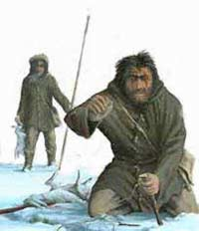
Periods of business development
Period 0: Insular
Very low capital intensity; no specialization; sporadic bartering
Small-scale Biz Entity | ___
Large-scale Biz Entity | Tribe; Village

Slide 55
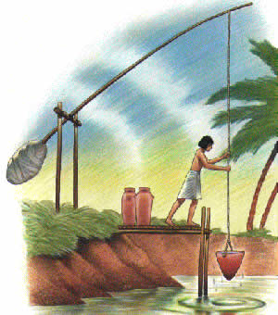
Periods of business development
Period 1: Pre-capitalist
Low capital-intensity; specialization/professionalization; constant trading
Small-scale Biz Entity | Family; General partnership
Large-scale Biz Entity | Manor; Guild

Slide 56
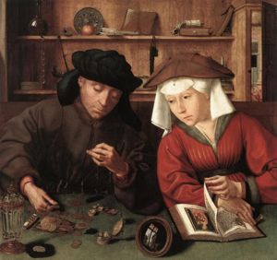
Periods of business development
Period 2: Commercial capitalism
Medium capital-intensity; capital & labor split; more risk-taking
Small-scale Biz Entity | Sea Loan; Limited partnership
Large-scale Biz Entity | Regulated company; Chartered corp.; Joint stock company

Slide 57
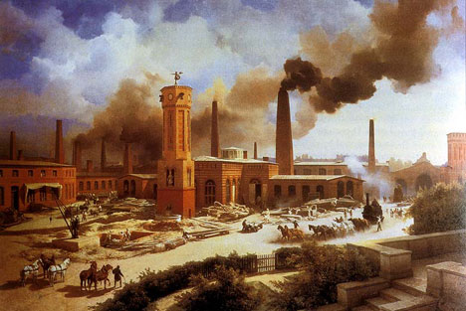
Periods of business development
Period 3: Industrial capitalism
High capital-intensity; factories; mass production & distribution
Small-scale Biz Entity | Limited liability company
Large-scale Biz Entity | Business trust; Business corporation

Slide 58
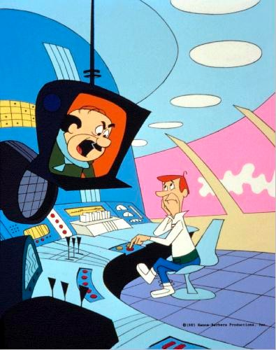
Periods of business development
Period 4: What next?
Will even larger markets change our business entities?
Small-scale Biz Entity | ???
Large-scale Biz Entity | ???

Slide 59
Evolution of business entities
Very rough chronology
Period 0: Insular (-1,000,000)
Period 1: Pre-capitalism (-3000)
Period 2: Commercial capitalism (1500)
Period 3: Industrial capitalism (1750)
Period 4: What next?

Slide 60
Period 0: Insular
Hunter-gatherer economy
Can sustain only low population density
  Need a lot of hunting/foraging land to get food
Tragedy of the commons
  No tribe has power to exclude others from land
  Result: over-hunting; extinction of animals
Very low security
  Tribes fight viciously to remove rivals
Very high variance in food surplus
  In good times food spoils, in bad times tribe starves
Slow, expensive movement of goods & information

Slide 61
Period 0: Insular
Consequences to business
Specialization is suicidal
  Everyone needed to collect food
  Relying on another tribe to provide a needed good is irrational
Trade is sporadic
  Killing other tribe makes more long-term sense than trading with it
  Lack of specialization means everyone produces same few goods (food, basic tools, clothes), so not much to trade
Money & inter-tribe collaboration are rare
  Why acquire money when you can’t eat it and there are not many opportunities to trade?
  Why collaborate with a rival tribe whose survival threatens you?

Slide 62
From Period 0 to Period 1
Early ancient agriculture
Irrigation, but no fertilizing, few crops, no use of animals
Lower variance in food surplus
  At mercy of weather, but more predictable yields
But low crop yields
  Just barely enough to feed farmers
  & for next year’s seeds
Low security
  Settlement is a sitting duck

Slide 63
From Period 0 to Period 1
Late ancient agriculture
Some fertilizing, more crops, early use of draft animals
Yields creep upwards, but just barely
  Food surplus allows a small number of non-farmers to specialize in other things (manufacturing for the settlement, full-time warriors)
  Villages form and grow
Slightly increased security
  Improved masonry allows creation of walls to protect village
  Full-time warriors allow some villages to take over others and consolidate into chiefdoms/kingdoms

Slide 64
From Period 0 to Period 1
Economic consequences
Trade becomes more regular
  Lower variance of food yield makes it safer to specialize
Specialization creates more goods
  Increased possibility of trade
  Specialists must trade to get food
Scale of production is very small
  Food surplus is small; community can afford few specialists
  Transportation costs high & security low
  Population density higher than in past, but still very low
Weakening of the tribe/village as an economic unit
  Tribe’s “safety net” replaced by family’s mutual support
  Borrowing and cross-tribe collaborations more common

Slide 65
Period 1
Early economic regulation of finance
Economic realities in Period 1
  Large fluctuation in prices / availability of goods
    Supply of goods
      Markets are small
      Markets are geographically proximate; affected by same conditions
    Supply of money fluctuates wo/relation to supply of goods
  Families accumulate very little capital
    Low surpluses mean little possibility of saving
  Tribe’s/village’s “safety net” disappears
    Increase in economic inequalities within the tribe/village
Consequences
  Most loans are for consumption, not investment
  Debtor has little collateral to pledge

Slide 66
Period 1
Early economic regulation of finance
From lender’s perspective
  Loans are very risky
  High interest rates & as much collateral as possible, to protect the risky loan
From borrower’s perspective
  Loan is a matter of life & death
  Losing the collateral may be a matter of life & death
Social & political pressure by borrowers leads to regulation of lending: likely the first regulation of voluntary economic relationships

Slide 67
History
Overview of Section 7a
Course overview
Pre-capitalist economic systems
Commercial capitalism
  The commercial revolution
  The joint stock company
Industrial capitalism

Slide 68
Evolution of business entities
Periods of biz org development
Period 0: No capital in business
  No specialization; sporadic bartering
Period 1: Low capital-intensive business
  Specialization/professionalization; constant trading
Period 2: Mid capital-intensive business
  Capital & labor split; entrepreneurs take greater risks
Period 3: High capital-intensive business
  Factories; mass production & distribution
Period 4?
  Will even larger markets change our business entities?

Slide 69
Business at the height of period 1
Most trade is between city and nearby farms
  Farms produce surplus food (& other goods for self-use only)
  Cities produce everything else, trade with farms for food
Production in cities governed by guilds
  Guilds set rules, guild members are independent businesses
  Each member (a master) employs apprentices & journeymen
  Small, low-risk operations; produce for known customers, mostly on demand

Slide 70
Evolution of Business Entities
From Period 1 to Period 2
Food Surplus / Pop. Density
Food Surplus (+)
Capital/Labor Ratio
Ag Tech
Population Density (-)
Trans Tech
Fast, Cheap Movement of Info & Goods
Com Tech
Market Size
Scale of Production
Capital Intensity
Efficient, reliable energy
Efficient, continuous production
Business Entity Law
Mil Tech
Security

Slide 71
Economic events in the transformation from period 1 to 2
The agricultural revolution of the Middle Ages
  Three-field system & crop rotation
    33% more land farmed w/less soil erosion
  Effective horse collar & horseshoes
    Use of draft horses for manual labor
    Draft horse produces ~432 ft.-lbs./sec; a man produces ~33 pumping and 45 turning a winch (500 ft.-lbs./sec = 1 horsepower)
  The heavy-wheeled plough
    Can now plough heavy soils and clear rocky/forested wilderness
  Warmer climate
    Northern Europe has better conditions for agriculture

Slide 72
Economic events in the transformation from period 1 to 2
Result: Grain yield up from ~2.5 (11C) to 4 (13C)
  Surplus grain up by 100%: from 1.5 to 3
  Only in 18C yields rise substantially higher (today’s yield: 20)
Surplus food allows more specialization
  More goods produced
    Greater surplus to trade
  More types of specialized goods produced
    More items to trade with others
  More people who do not produce food require more trade

Slide 73
Economic events in the transformation from period 1 to 2
Increased security in Western Europe
  Great invasions over (Vikings, Germanic tribes, Muslims)
    Mediterranean opens up to Christian trade
  More surplus food allows creation of larger armies
  More surplus food over time results in rulers accumulating more capital, which is invested in their military
  Stirrup and barding (horse armor) create an effective cavalry (Knights)
    Travel more quickly
    Easily defeat peasant infantry, except in rough terrain
    Result: Rich rulers consolidate control over larger territory

Slide 74
Economic events in the transformation from period 1 to 2
Other developments
  Effective horse collar – horses can carry wagons
    Increases the weight each horse can carry – land trade becomes more cost effective
  Crusades create familiarity with middle eastern & far eastern goods

Slide 75
Economic events in the transformation from period 1 to 2
Consequences of increased size of market
Potential for profits from long-distance trade (other towns & far away lands)
  Safer to travel between towns
  More powerful sovereigns are better able to protect their merchants from foreign rules
Guilds are not suited to regulate LD trade
  Guildmaster does not have information advantage regarding demand outside city
  Guild members have very little capital & labor
  Expanding the market may destabilize the guild’s cartel

Slide 76
Economic events in the transformation from period 1 to 2
Consequences of increased size of market
The capitalist starts to dominate production
  Capitalist typically accumulated capital from trade
  Capital is invested in large-scale purchases of machines
  “Putting out” system: Machines given to peasants, who are paid wages to work in their spare time
    Plenty of labor available. Why didn’t peasants move to city to work?
  Capitalist uses agents to monitor foreign market conditions
  Production is not made to order; capitalist takes some risks in producing without assurance of a market
    Why can the capitalist take greater risks than the guild members?

Slide 77
Economic events in the transformation from period 1 to 2
Consequences of increased size of market
Greater need (and use) for capital & greater risk-taking makes SPs & GPs less than ideal biz entities
  Larger number of owners needed to
    Accumulate large capital
    Share the increased risks among owners
Impact for business entities
  Increased role for passive investors, who want:
    Limited liability
    Transferable shares
  Increased need to separate control from ownership

Slide 78
Guild vs. Capitalism
Guild system – commerce is driven by production
  Guilds regulate output to maintain monopoly price
  Low capital, labor & risk-taking limits production capacity
Capitalist system – production is driven by commerce
  Capitalist who identifies demand has capital and labor that can easily increase production
  Capitalist values more than guild acquiring information about demand outside immediate surroundings

Slide 79
Political Support for Capitalism
Rulers consolidate large kingdoms
  But culture in different regions still distinctly different
  Rulers try to fuse a unified culture; local power brokers resist
Rulers need more money
  Military technology costs rise
  A larger bureaucracy has significant costs
  Increased mining and (later) flow of gold/silver from New World cause prices to rise
  Rulers look for ways to acquire more money

Slide 80
Political Support for Capitalism
Resulting economic policy: Mercantilism
  Sell more goods to other countries than they sell to you
  This way, they need to pay you money to cover their deficit
How to sell more than you buy?
  Increase country’s production
    Employ idle labor
    Increase number of industries
  Encourage exports
    Especially of more expensive, finished goods
  Discourage imports
    Except raw materials made into finished goods
  Bring skilled foreign labor; keep own skilled labor

Slide 81
Political Support for Capitalism
Capitalist is the natural ally of a mercantilist ruler
  Employs farmers in industrial production
  Interested in increasing production & expanding markets
    Unlike guilds, which want to restrict demand
  Interested in expanding into new industries
Rulers nurture capitalists
  Use their power to protect merchants in foreign lands
  Offer subsidies for exporting
  Back capitalists against guilds & other local interests
  Give monopolies & other concessions (such as right to incorporate)

Slide 82
History
Overview of Section 7a
Course overview
Pre-capitalist economic systems
Commercial capitalism
Industrial capitalism
  Demand for incorporation
  Public purpose
  General incorporation statutes
  Antitrust: a missed opportunity for corporate law?

Slide 83
Period 3
Industrial capitalism
As the Western economies moved from period 2 to period 3, more businesses began to seek incorporation
  Government initially resisted the push, then relented
I will explain in this presentation the economic forces that caused businesses to increasingly want to incorporate

Slide 84
Evolution of Business Entities
Periods of Biz Org Development
Period 0: No capital in business
  No specialization; sporadic bartering
Period 1: Low capital-intensive business
  Specialization/professionalization; constant trading
Period 2: Mid capital-intensive business
  Capital & labor split; entrepreneurs take greater risks
Period 3: High capital-intensive business
  Factories; mass production & distribution
Period 4?
  Will even larger markets change our business entities?

Slide 85
Evolution of Business Entities
From Period 2 to Period 3
Food Surplus / Pop. Density
Food Surplus (+)
Capital/Labor Ratio
Ag Tech
Population Density (-)
Trans Tech
Fast, Cheap Movement of Info & Goods
Com Tech
Market Size
Scale of Production
Capital Intensity
Efficient, reliable energy
Efficient, continuous production
Business Entity Law
Mil Tech
Security

Slide 86
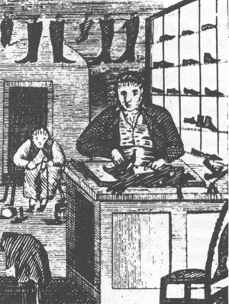
Business at the Height of
Period 2
Production is driven by commerce
  Most production done by artisans, in small scale operations employing only animate sources of energy (humans & animals)
  Some capitalists trade in large scale,
  but even they typically have products
  made in (multiple) small-scale shops
  Hardly any professional managers:
  owners manage; operations too small
  to require managers
    Exception: (Slave-operated) Plantations
This is still the prevalent situation
in 1830s America

Slide 87
Business at the Beginning of
Period 3
But by 1900, a majority of industries have shifted to much larger scales & using more capital
  Factories (using inanimate energy & employing full-time salaried employees) begin to dominate production
  Professional managers govern these firms

Slide 88
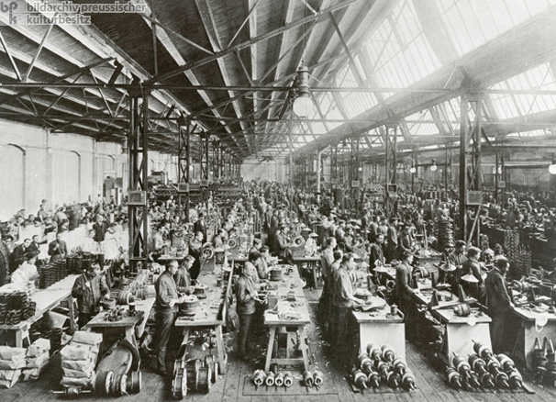
Business at the Beginning of
Period 3
Factory, c. 1900
What caused the change?

Slide 89
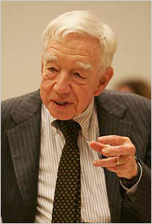
Chandler’s Theory
Before 1830s American businesses did not
face economic conditions that justified
large-scale business
  Shortage of labor
  Poor availability of reliable (24/7) energy source
  Costly, slow land transportation
In mid-19th century, US economy hit by “perfect storm”
  Commerce revolutionized by railroads (cheap transportation)
  Industry revolutionized by availability of coal & steam engine (continuous production)

Slide 90
Chandler’s Theory
Result
Increased demand to incorporate
Scale of biz increases
More complex biz org / More capital needed
But why do continuous production & cheap transportation cause an increase in the scale of business?
  To understand this, we need to consider how businesses decide how much to produce
  Key term: minimum efficient scale

Slide 91
Understanding Chandler’s Theory
Hypothetical
You are a widget producer in a competitive market
  Market price for widgets is $6
Producing a widget:
  1 employee operating 1 machine takes 1 hour to produce 1 widget
    Employee’s wage: $4/hour
    Machine is wind-powered – no energy costs
  Raw materials cost another $1 per widget
  Rent for the factory is $10/day (regardless of # of widgets produced)
How much does it cost to produce a widget using the wind-powered machine (not counting the rent)?

Slide 92
Understanding Chandler’s Theory
Hypothetical
Production constraints
  It’s windy only 4 hours/day; rest of the day machines don’t work
  Factory has room for up to 5 machines
  Therefore, machines can produce up to 20 widgets/day
Additional widgets can be produced using manual force
  This takes longer: 2 hours/widget
How much does it cost to produce a widget manually (not counting the rent)?

Slide 93
Understanding Chandler’s Theory
Hypothetical
Firm maximizes profits at 20 widgets
Above that, it loses $3 on each widget sold
Widget Output (Q) | Total Cost | Avg. Total Cost (TC/Q) | Total Revenue ($6 x Q) | Profit (Loss) (T. Rev. – T. Cost)
18 | $100 | $5.56 | $108 | $8
19 | $105 | $5.53 | $114 | $9
20 | $110 | $5.50 | $120 | $10
21 | $119 | $5.67 | $126 | $7
22 | $128 | $5.82 | $132 | $4
23 | $137 | $5.96 | $138 | $1

Slide 94
Understanding Chandler’s Theory
Minimum Efficient Scale

Slide 95
Understanding Chandler’s Theory
Effect of Energy Sources
Coal-powered machines now available
  Each machine consumes $3 worth of coal/hour
  Machine works non-stop; produces two widgets per hour w/1 employee
  Employees work the machine in shifts, maintaining production 24/7
  Machines were bought on credit; installment payments are $10/day
Cost
  2 widgets cost $3 coal + $4 wages + $1 raw materials = $8
  Variable cost per widget: $4
  Fixed costs per day: $20 ($10 rent, $10 machine installment payment)
Capacity
  Factory has room for up to 5 machines
  Machines can produce up to 240 widgets/day
    5 machines x 24 hours x 2 widgets per hour

Slide 96
Understanding Chandler’s Theory
Comparing Wind & Coal
Wind MES
Coal MES

Slide 97
Understanding Chandler’s Theory
Comparing Wind & Coal
Production method depends on demand
  Demand <11: Wind-based production; likely monopoly (Wind MES=20)
  11<D<20s: Either wind or coal possible
    Wind incumbent may deter coal entrant:
      Entrant would need to get >50% market share to have lower costs
      Even at 20 widgets, cost difference is not large
      Market is small so less attractive to invest in capturing it
  20s<D<240: Coal-based production; likely monopoly (MES=240)
  D>240: Coal-based production; competition between firms

Slide 98
Understanding Chandler’s Theory
Effect of Cheap Transportation
Cheap transportation made it economically feasible to sell products to a larger market
  Increases demand, and therefore the economic feasibility of continuous production

Slide 99
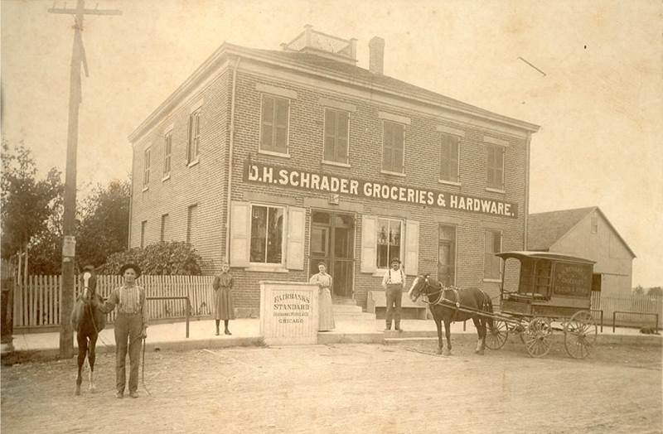
What triggered the antitrust movement?
The ever-present monopoly problem
Throughout history, many (probably most) businesses
enjoyed a great deal of market power
  Even in 19C America, many communities had just one general store; one bank, etc. Why?

Slide 100
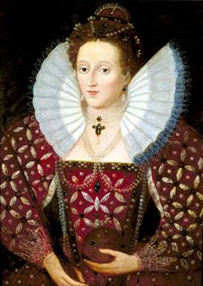
What triggered the antitrust movement?
Early anti-monopoly movements
Occasionally rulers faced political backlash when they granted monopolies to businesses
  E.g., Case of Monopolies (Eng., 1602)
  Pressure mostly from rival producers, not customers
  Political support from parliament (turf war against monarch)
  Focused on government granting monopoly,
  not on the producer maintaining it
  Why did rulers grant monopolies?
  Causes of the backlash
    Increase in expenditures (wars)
    Manufacturing & trade gain vs. agriculture
      Relative decline in land-based feudal taxes
      Increase in parliament’s power vs. monarch

Slide 101
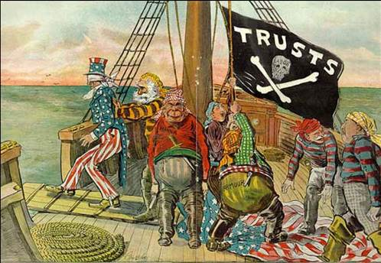
What triggered the antitrust movement?
The 19C antitrust movement
The late 19C saw the rise of a different movement
  Focus on curbing the power of businesses
  Push from customers (e.g., farmers using railroads), not rivals
  President & Congress could be on same side of the issue
Why then & not earlier?

Slide 102
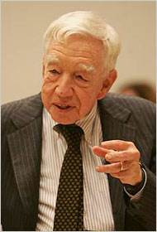
Chandler’s Theory
To understand why antitrust became a major concern in the beginning of period 3, we need to go back to Alfred Chandler’s theory (from Section 1c)
In mid-19th century, US economy hit by “perfect storm”
  Cheap transportation: Commerce revolutionized by railroads
  Continuous production: Industry revolutionized
  by availability of coal & steam engine

Slide 103
Understanding Chandler’s theory
Hypothetical from Section 1d
Producing a widget:
  Rent for the factory is $10/day (regardless of # of widgets produced)
  Raw materials cost another $1 per widget
  1 employee operating 1 machine for 1 hour produces 1 widget
    Employee’s wage: $4/hour
    Machine is wind-powered – no energy costs
    It is only windy 4 hours/day (rest of day machines are unusable)
    Factory has room for 5 machines
      So max machine production is 20/day (4 hours x 1 per hour x 5 machines)
To produce >20/day, you must produce them manually
  This takes longer: 2 hours per widget

Slide 104
Understanding Chandler’s theory
Minimum efficient scale
MES = 20 widgets

Slide 105
Understanding Chandler’s theory
Hypothetical from Section 1d
Can Replace wind-powered machines with coal-powered ones
  Each machine consumes $3 worth of coal/hour
  Machine works non-stop; produces two widgets per hour w/1 employee
  Employees work the machine in shifts, maintaining production 24/7
  Machines were bought on credit; installment payments are $10/day
Cost
  2 widgets cost $3 coal + $4 wages + $1 raw materials = $8
  Variable cost per widget: $4
  Fixed costs per day: $20 ($10 rent, $10 machine installment payment)
Capacity
  The factory has room for 5 machines
  Therefore, your machines can produce up to 240 widgets per day

Slide 106
Understanding Chandler’s theory
Comparing wind & coal ATCs
Wind MES
Coal MES

Slide 107
Understanding Chandler’s theory
Effect of cheap transportation
Cheap transportation made it economically feasible to sell products to a larger market
  Increases demand, and therefore the economic feasibility of continuous production

Slide 108
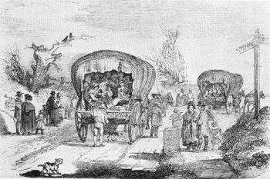
Understanding Chandler’s theory
Effect of cheap transportation
Example: Widget factory is located in Urbana, IL
  Year is 1843 – 10 years after Urbana was founded
  Urbana residents & neighboring farms buy 10 widgets/day
  Chicago residents buy 500 widgets/day
  Coal-powered machines are available
  Transporting widgets by horse & wagon costs $2/widget
What should the Urbana factory do?
  Use wind or coal?
  Sell to Chicago?
What will the Chicago factories do?
  Use wind or coal?
  Sell to Urbana?

Slide 109
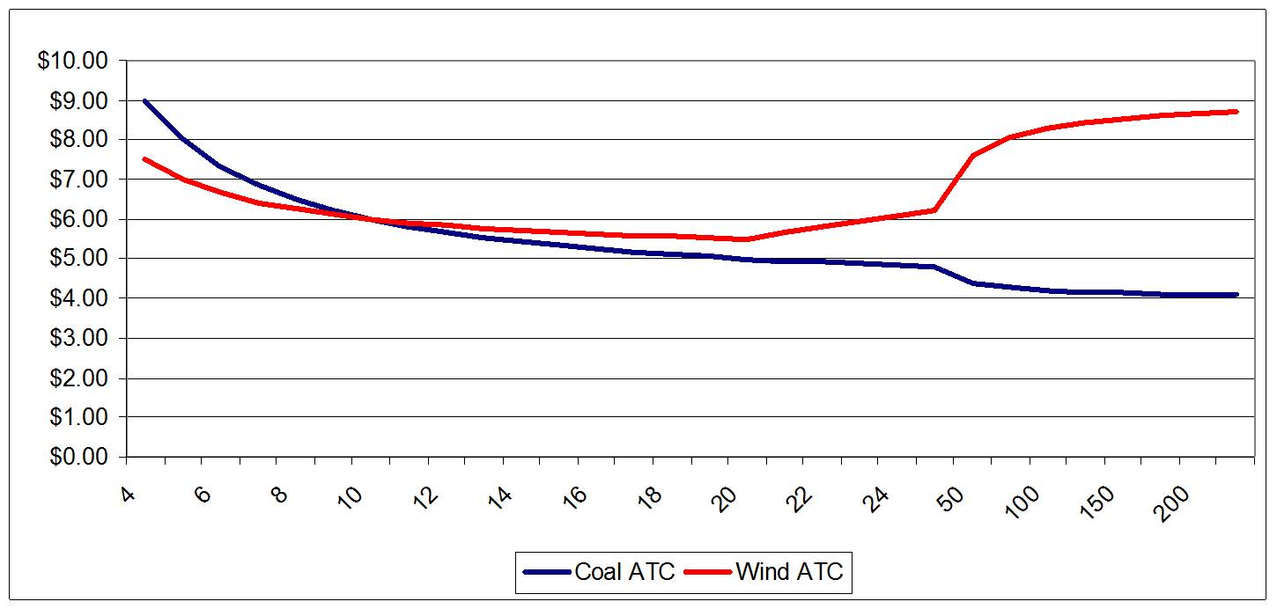
Understanding Chandler’s theory
Competition in 1843 hypo
Trans. Costs: $2

Slide 110
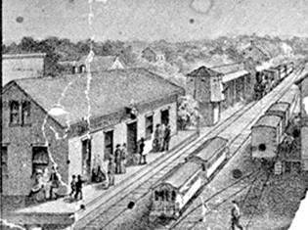
Understanding Chandler’s theory
Effect of cheap transportation
Now the year is 1854: Illinois Central Railroad reached Urbana
  It now costs $0.20/widget to transport
What will the Chicago factories do?
What should your Urbana factory do?

Slide 111
Understanding Chandler’s theory
Competition in 1854 hypo
Trans. Costs: 20¢

Slide 112
Understanding Chandler’s theory
Origin of the antitrust movement
Urbana widget producer has three options:
Close the factory
  Chicago firms will supply Urbana
Switch to coal plant & extend sales to Chicago
  If at least 150 widgets sold, costs will be similar to large Chicago firms
  Business risk to Urbana firm; threat to Chicago firms
Collude with Chicago firms
  E.g., divide markets

